Slide 1
Technical Support (420-1N6-AB) Microsoft Hyper-V
Fall 2023

Slide 2
Outline
Hyper-V Introduction
Installing Hyper-V
Creating a Virtual Machine (VM)
VM Checkpoints
Nested Virtualization

Slide 3
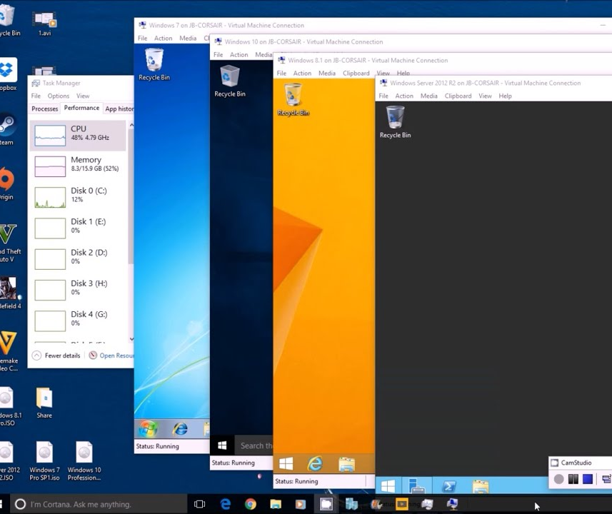
Virtualization & MS Hyper-V
As programmers or IT professional the need to run multiple operating systems is essential.
Why?
Experiment with other operating systems.
Run software that requires other operating systems or an older versions of Windows.
Test software on multiple operating systems.
Hyper-V a solution from Microsoft allows users to run multiple operating systems as virtual machines on Windows.

Slide 4
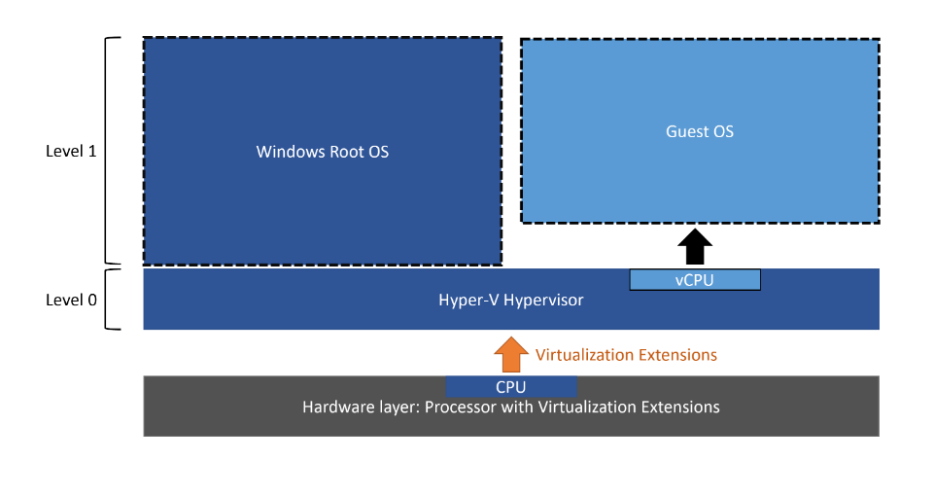
Hyper-V Architecture

Slide 5
Hyper-V Installation Requirements
Windows Version:
Windows 10 Enterprise, Pro, or Education.
64-bit Processor with Second Level Address Translation (SLAT)
(https://en.wikipedia.org/wiki/Second_Level_Address_Translation)
CPU support for VM Monitor Mode Extension.
Minimum of 4 GB memory.

Slide 6
What OS can run on Hyper-V?
Windows supported versions:
https://docs.microsoft.com/en-us/virtualization/hyper-v-on-windows/about/supported-guest-os
Linux \ FreeBSD supported versions:
https://docs.microsoft.com/en-us/windows-server/virtualization/hyper-v/Supported-Linux-and-FreeBSD-virtual-machines-for-Hyper-V-on-Windows

Slide 7
Hyper-V Limitations
Applications that depend on specific hardware will not work well in a virtual machine.
Example: a game that require processing with a GPU might not work well on a VM.

Slide 8
Install Hyper-V on Windows 10

Slide 9
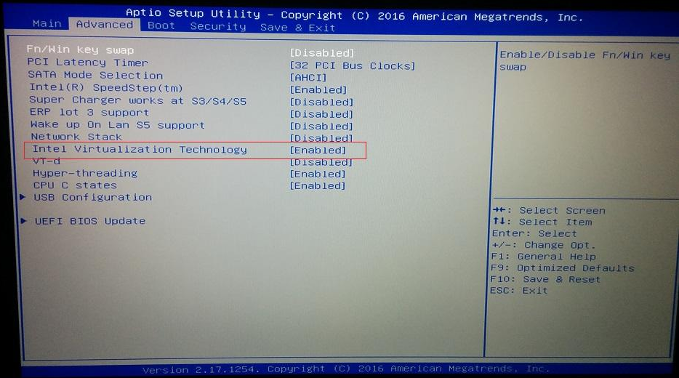
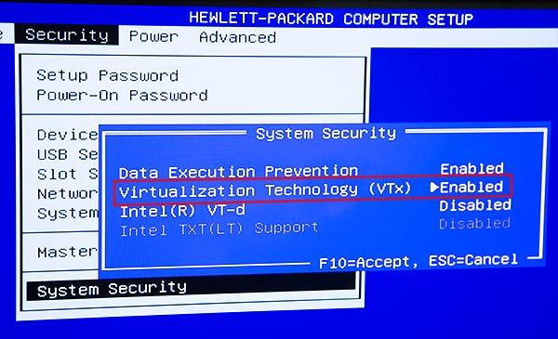
1. BIOS / EUFI Settings
Before starting, go to BIOS/EUFI and ensure that hardware virtualization support is enabled.

Slide 10
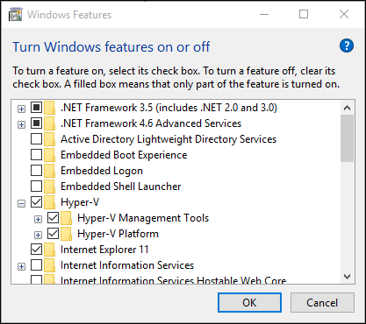
2. Enable Hyper-V on Windows 10
Enable from PowerShell
Run as administrator.
Command: Enable-WindowsOptionalFeature -Online -FeatureName Microsoft-Hyper-V –All
Enable from Settings
Right click on the Windows button and select ‘Apps and Features’.
Select Programs and Features on the right under related settings.
Select Turn Windows Features on or off.
Select Hyper-V and click OK.
After installation is completed computer requires reboot.

Slide 11
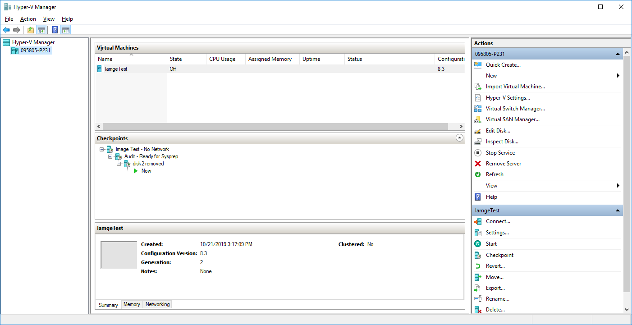
Hyper-V Manager

Slide 12
Creating a Virtual Machine (VM)

Slide 13
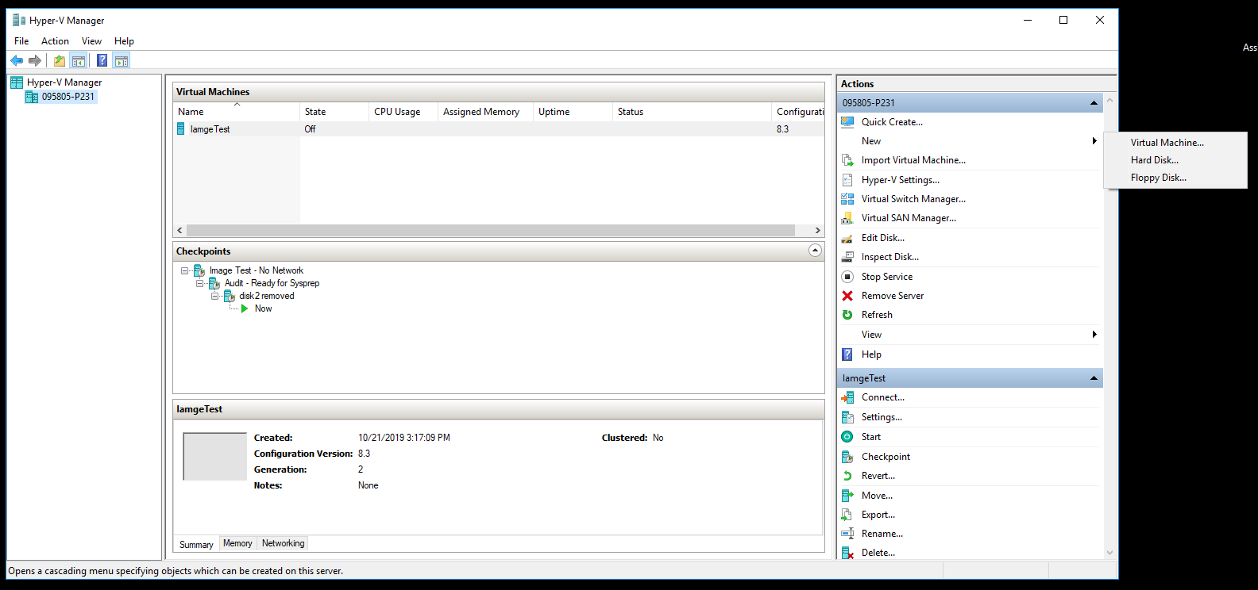
Creating a New VM

Slide 14
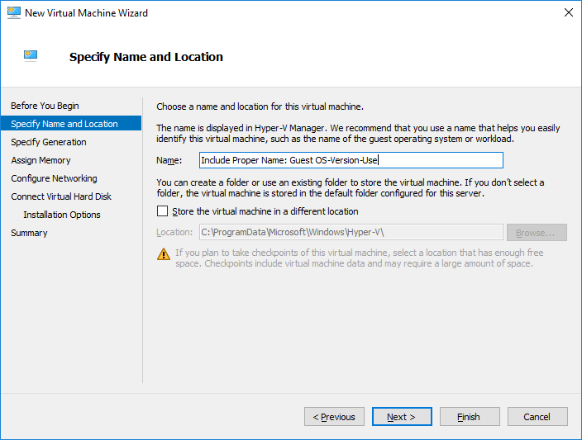
New VM Settings: Name and Location
Name:
Choose a meaningful name.
Include host OS name and version.
Include VM purpose or use.
Change Location if needed.

Slide 15
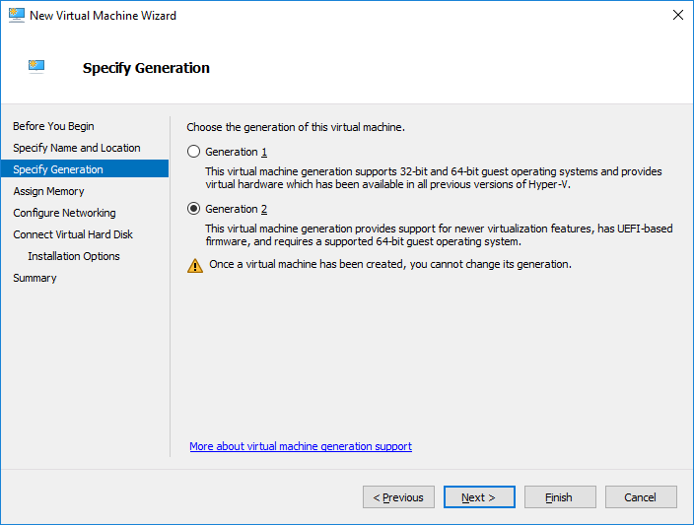
New VM Settings: VM Generations
There are two generations of Hyper-V VM:
Generation 1
Generation 2.
The choice of VM generation depends on:
Host operating system
Guest operating system
Boot methods.

Slide 16
Advantages Generation 2 VMs
Higher performance
1 TB RAM for Generation 1 VMs vs 12 TB RAM for Generation 2 VMs;
64 virtual processors for Generation 1 VMs vs 240 virtual processors for Generation 2 VMs.
UEFI\BIOS Support
Higher security with Secure Boot and Trusted Platform Module.
More boot options:
PXE boot with synthetic network adapter.
Boot from SCSI disk.
Support of VHDX virtual hard disks with higher maximum disk size.
Copying Files from Hyper-V Host to VMs without Network Connection of VMs.

Slide 17
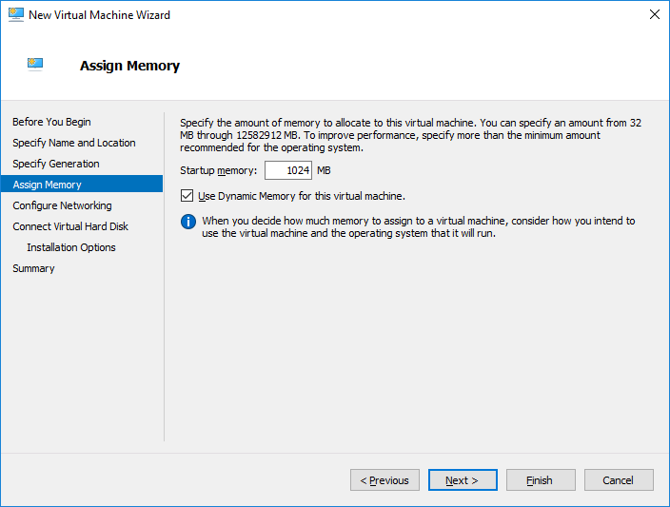
New VM Settings: Memory
Dynamic memory is a Microsoft Hyper-V feature allows to handle RAM consumption by host VMs in a flexible way.
Memory is allocated to guest-OS VM when needed. Memory is released when VM goes idle.

Slide 18
Hyper-V Dynamic Memory Configuration
Dynamic memory configuration is only available on Windows Server Hyper-V hosts:
Startup RAM: Amount of RAM assigned to the VM during its startup.
Minimum RAM: Minimum amount of RAM that the host should be trying to assign to a VM, when it’s booted.
When multiple VMs are demanding memory, the Hyper-V host can reallocate RAM away from the VM until this minimum RAM value is met.
Maximum RAM: Maximum amount of RAM that the host provides to a VM.
Memory buffer: Percentage of memory that Hyper-V should allocate to the VM as a buffer.
Memory weight: The priority for this VM compared to other VMs running on the same Hyper-V host.

Slide 19
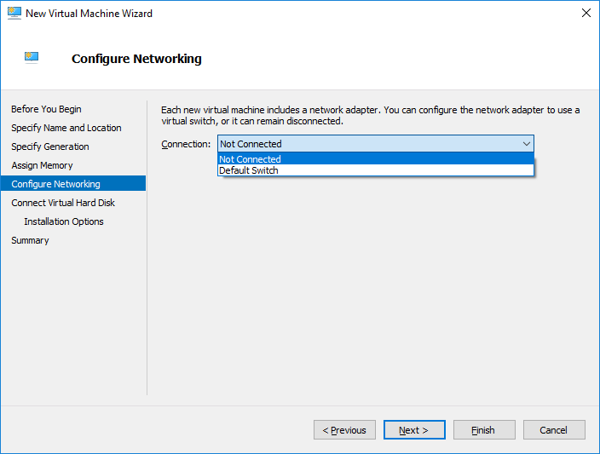
New VM Settings: Networking

Slide 20
Virtual Networks & Switches
A VM will need a virtual network to share a network with the host computer.
Creating a virtual network is optional if the VM does not need to be connected to the internet or a network.
To create a virtual network, you need to create a virtual switch.
A virtual switch allows VMs created on Hyper-V hosts to communicate with other computers or VMs.

Slide 21
Types of Virtual Switches
External | Gives VMs access to a physical network to communicate with servers and clients on an external network. Allows VMs on the same Hyper-V server to communicate with each other.
Internal | Allows communication between VMs on the same Hyper-V server. Allows communication between the VM and the management host operating system.
Private | Only allows communication between VMs on the same Hyper-V server. A private network is isolated from all external network traffic on the Hyper-V server.

Slide 22
Creating a Virtual Switch
A default virtual switch is created when installing Hyper-V.
The default virtual switch uses an internal networking setting.
To add another virtual switch
Open Hyper-V Manager
Select the Hyper-V host computer name. (right-hand side)
Select Action > Virtual Switch Manager.
Choose the type of virtual switch.
Select Create Virtual Switch.

Slide 23
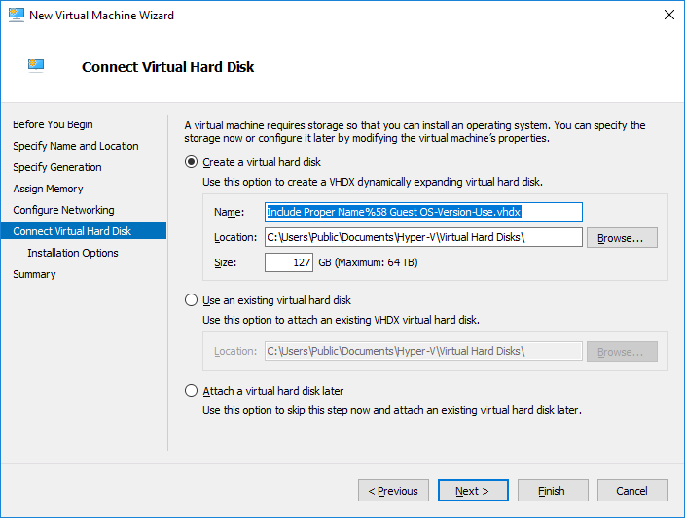
New VM Settings: Hard Disk
VHDs are virtualized hard disk files.
Once mounted to an OS, they will appear and operate pretty much identically to a physical hard drive.
A VHD is commonly accessed, managed and installed on VMs.

Slide 24
VHDX
VHDX is a new virtual hard disk format introduced in Windows Server 2012.
Support for virtual hard disk storage capacity of up to 64 terabytes.
Protection against data corruption during power failures by logging updates to the VHDX metadata structures.
Ability to store custom metadata about a file, which a user might want to record, such as operating system version or patches applied.

Slide 25
Types of VHD
Fixed virtual hard disk
VHD size is allocated when the VHD file is created.
Recommended on VMs that require many I/O operations.
Dynamic virtual hard disk
Space for the VHD is allocated on demand.
The blocks in the disk start as unallocated blocks and are not backed by any actual space in the file.
Differencing virtual hard disk
Points to a parent VHD file.
Contains block data that represents changes to a parent VHD.
Changes can be reversed if necessary.

Slide 26
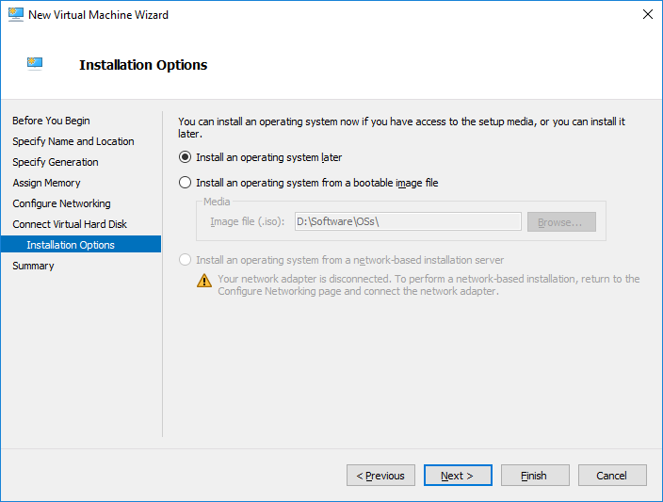
New VM Settings: OS Installation
An OS can be installed on VM using an ISO file of the OS.
OS installation can be done through other boot option later.
Network boot.
Attached bootable devices.

Slide 27
VM Checkpoints

Slide 28
What are VM Checkpoints?
A VM checkpoint is a saved state of the virtual machine.
Checkpoints in Hyper-V are used to revert virtual machines to a previous state.
Checkpoint are usually created before:
Making software configuration changes.
Applying a software update
Installing new software.
If the changes added to the system were to cause any issue, the virtual machine can be reverted to the state at which it was when then checkpoint was taken.

Slide 29
Checkpoint Types
Standard Checkpoints
Takes a snapshot of the VM and VM’s memory state.
A snapshot is not a full backup.
Production Checkpoints:
Creates a data-consistent backup of the virtual machine.
The VM’s memory snapshot is not taken.

Slide 30
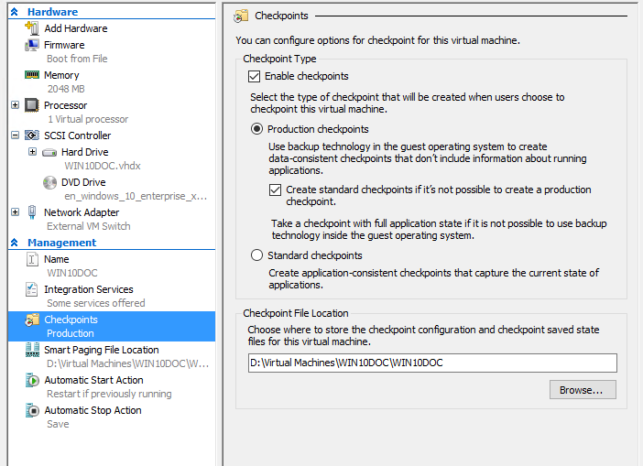
Changing Checkpoint Type
Open Hyper-V Manager.
Right click on a virtual machine and select settings.
Under Management select Checkpoints.
Select the desired checkpoint type.

Slide 31
Creating Checkpoints
In Hyper-V Manager, select the virtual machine.
Right-click the name of the virtual machine, and then click Checkpoint.
When the process is complete, the checkpoint will appear under Checkpoints in the Hyper-V Manager.
Note: The created checkpoint will be of the type configured for the virtual machine settings.

Slide 32
Applying a Checkpoint
In Hyper-V Manager, select the virtual machine.
In the Checkpoints section, right-click the checkpoint that you want to use and click Apply.
A dialog box appears with the following options:
Create Checkpoint and Apply: Creates a new checkpoint of the VM before it applies the earlier checkpoint.
Apply: Applies only the checkpoint that you have chosen. You cannot undo this action.

Slide 33
Nested Virtualization

Slide 34
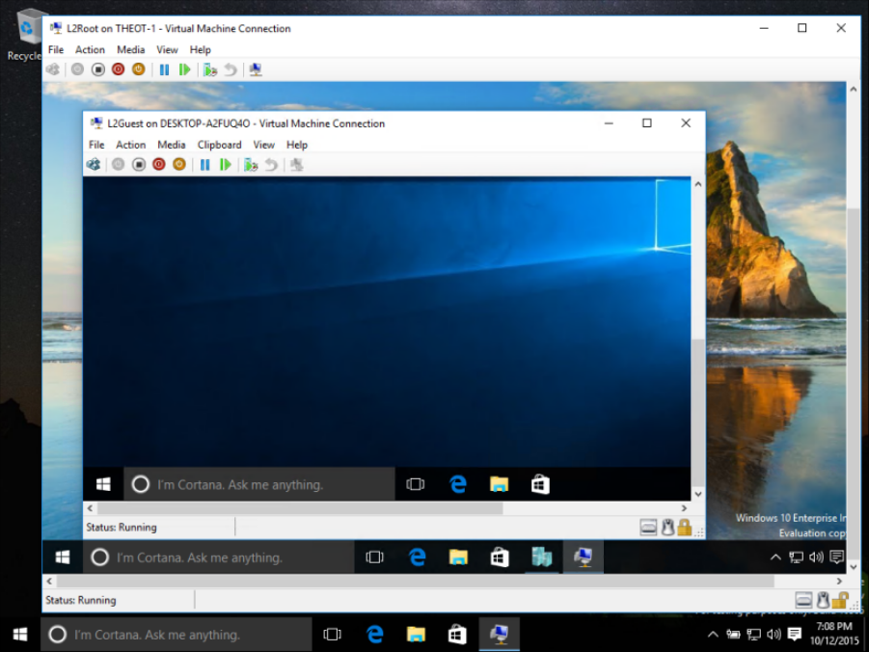

Slide 35
Nested Virtualization
Nested virtualization is a feature that allows the user to run a virtual machine from within another virtual machine.
Run Hyper-V inside of a Hyper-V virtual machine (VM).
Useful for:
Running a phone emulators
Testing configurations that ordinarily require several hosts.

Slide 36
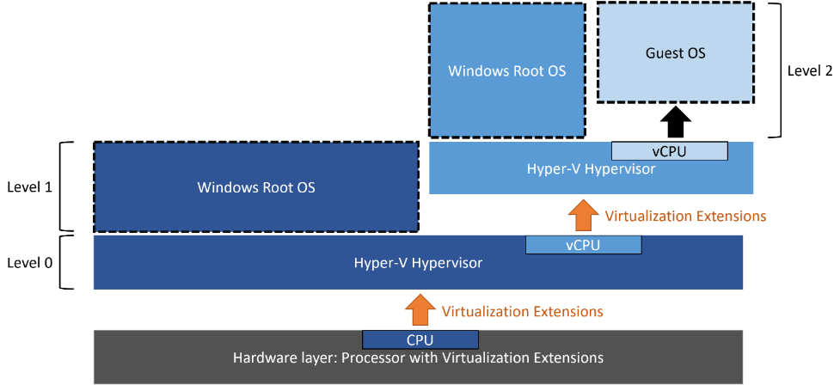
Nested Virtualization Diagram

Slide 37
Nested Virtualization Complications
Hardware Limitations
CPU allocation.
Memory allocation.
Network Connections
The host VM needs to differentiate between its own network traffic and nested VM.

Slide 38
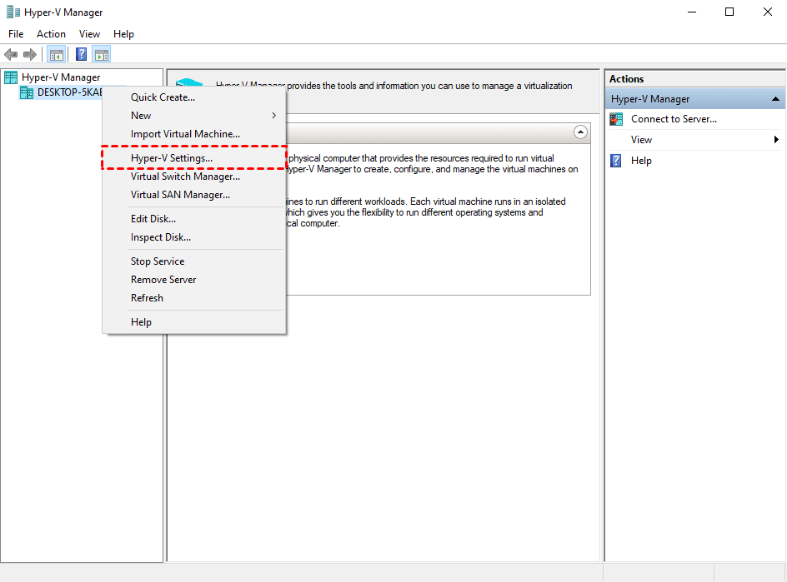
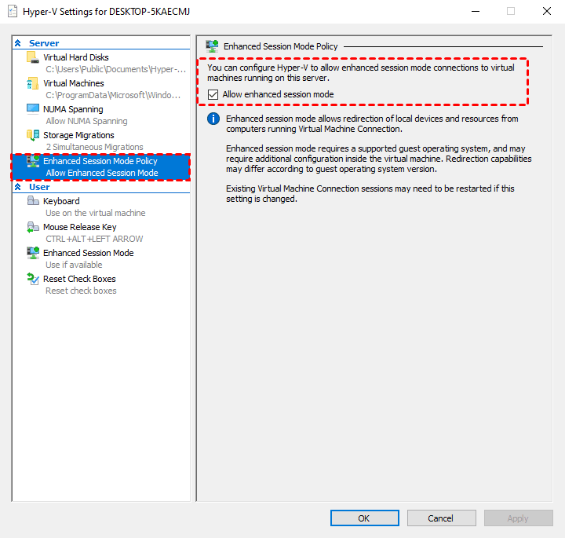
How to enable copy and paste

Slide 39
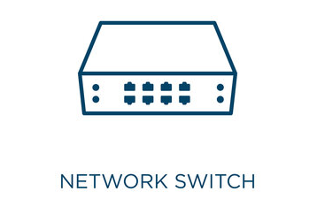
Network Switch
Device which connects devices within a network and forwards data packets to and from a device.
It uses the MAC address (physical address given by the manufacturer and uniquely identifies each device) of the computer.
More on that on the Introduction to Networking Lecture

Slide 40
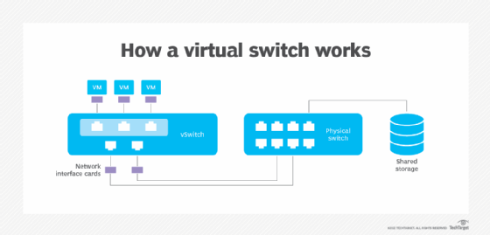
Virtual Switch
Similar to physical switches.
Emulates a switch in Hyper-V to connect the Virtual Machine to the Internet

Slide 41
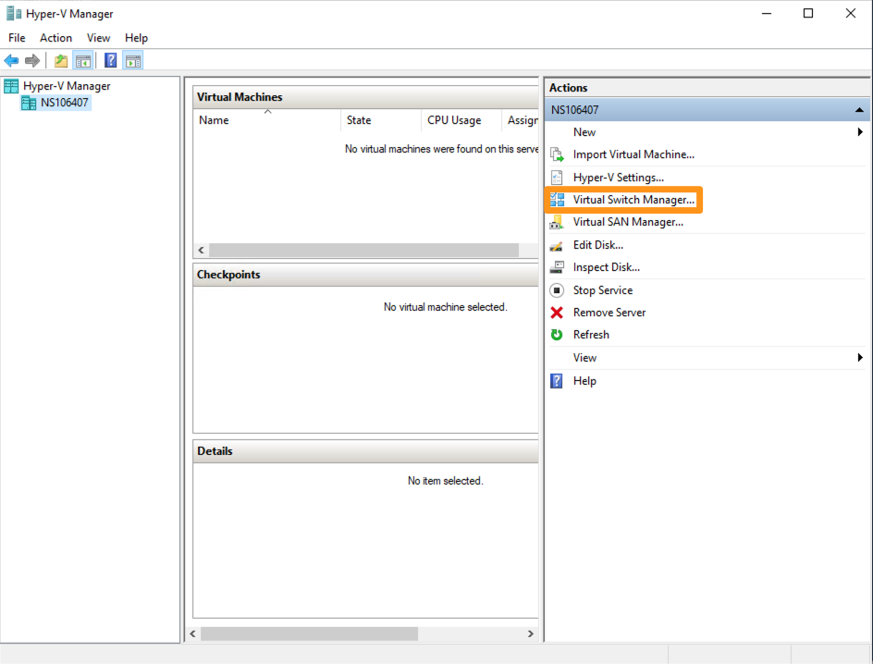
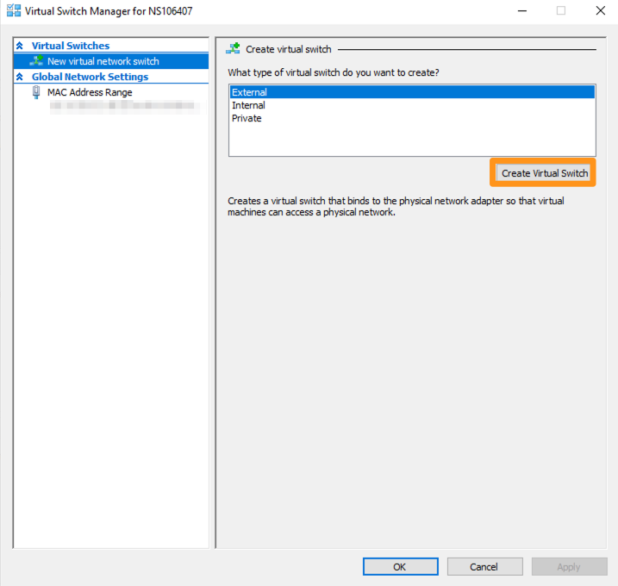
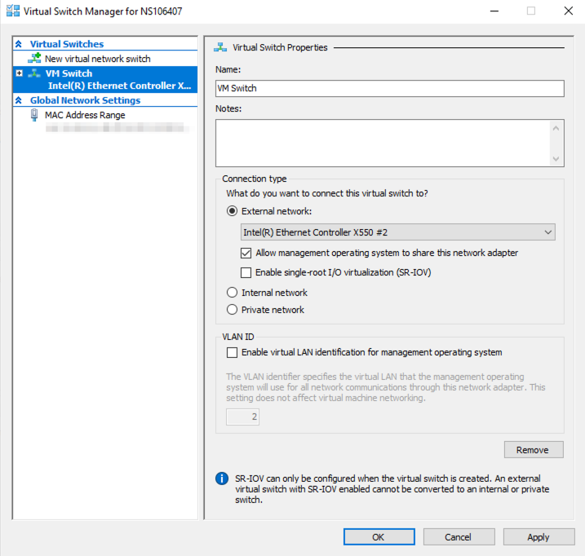
Step 1 : Open the Switch Manager and add an External Switch
Internet connection lost momentarily!

Slide 42
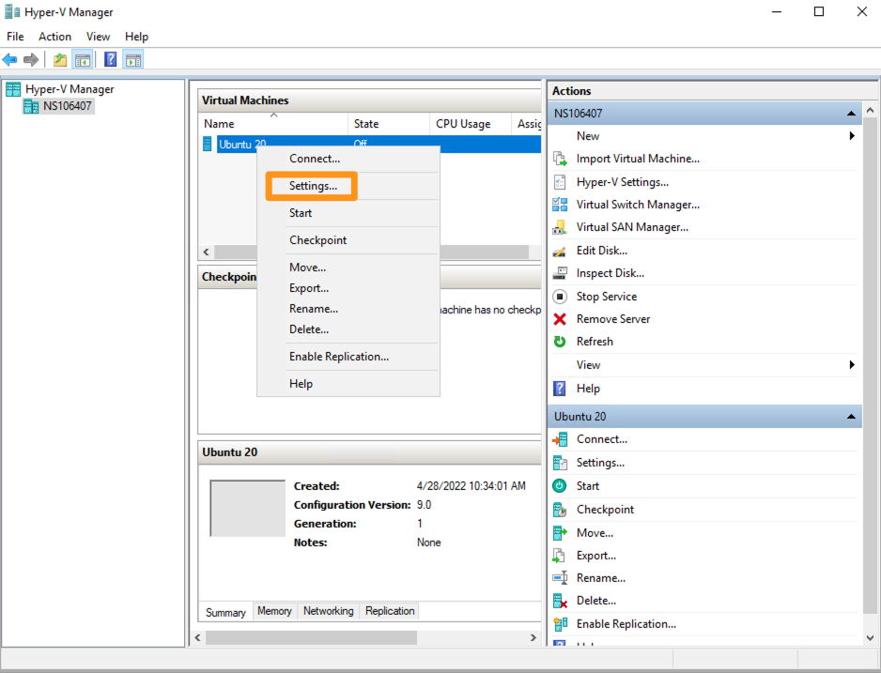
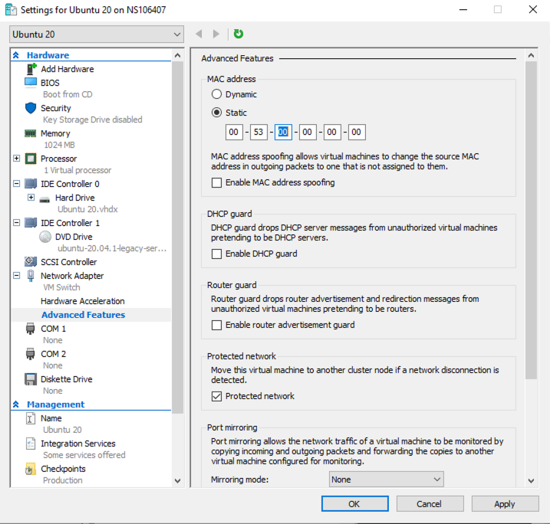
Step 2: (optional) Assign an Ip Address to the vSwitch

Slide 43
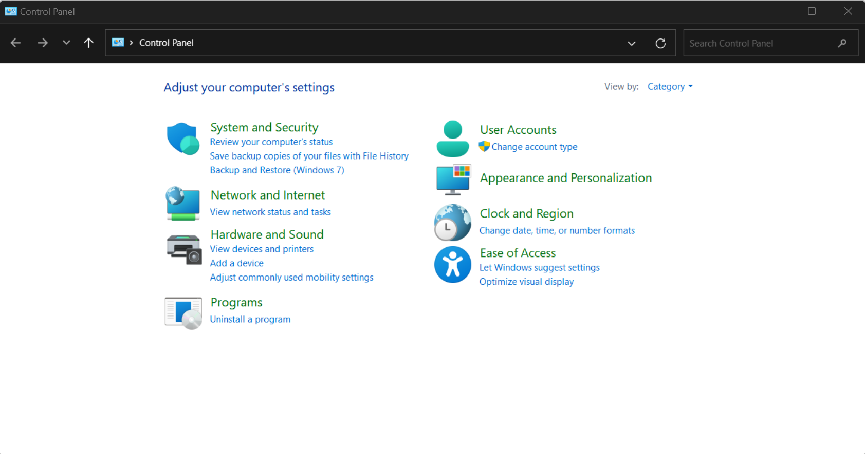
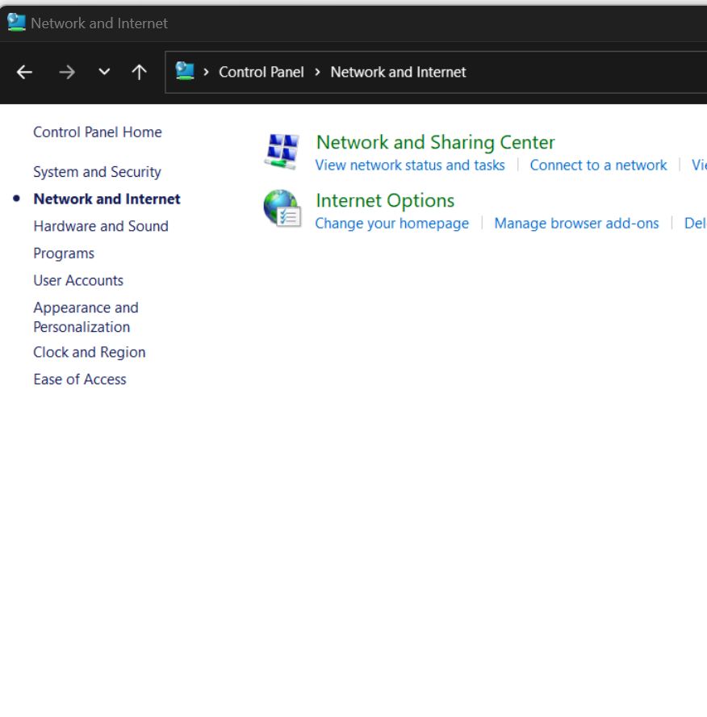
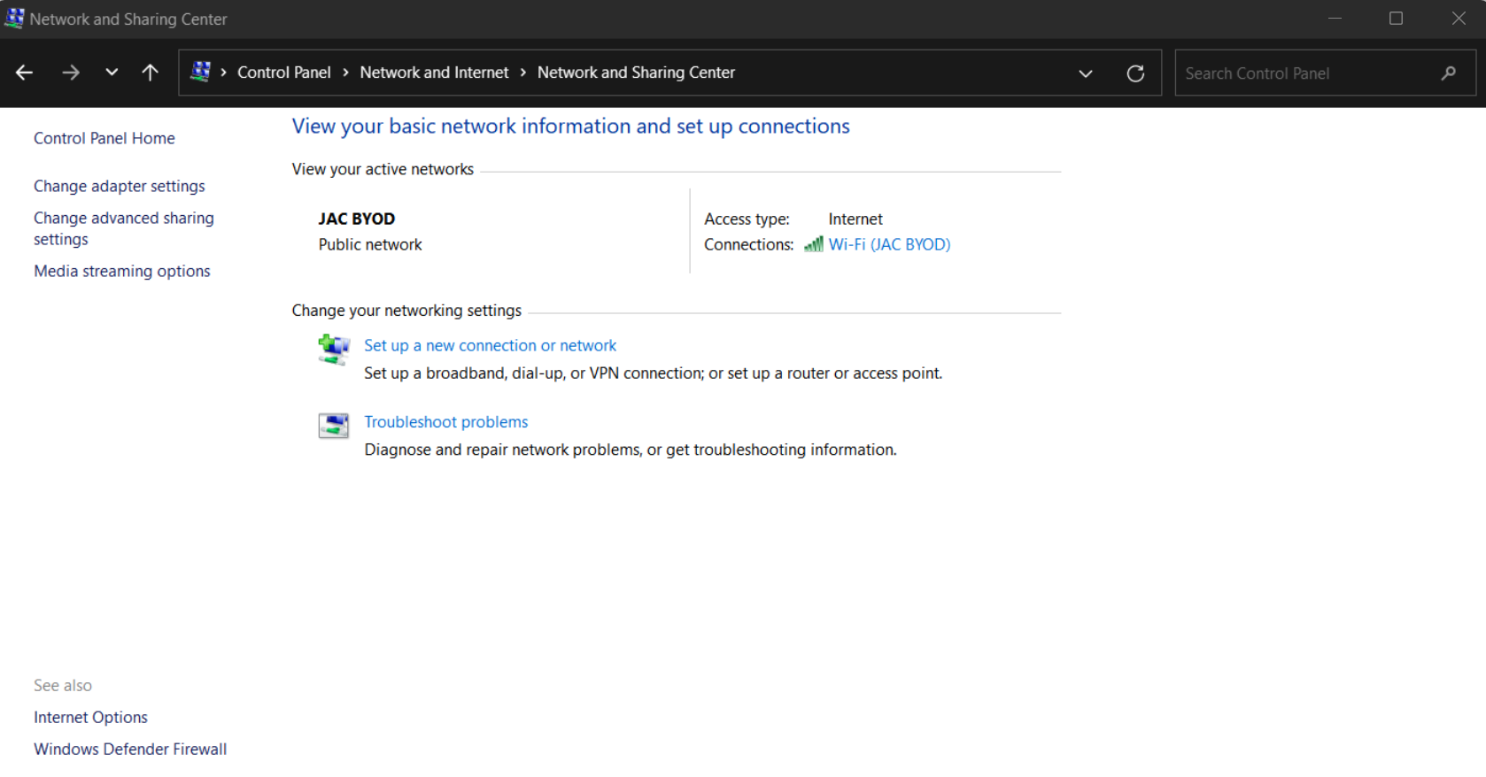
Sharing file between VM and Host PC
Step 1: On Host Machine: open the Control Panel

Slide 44
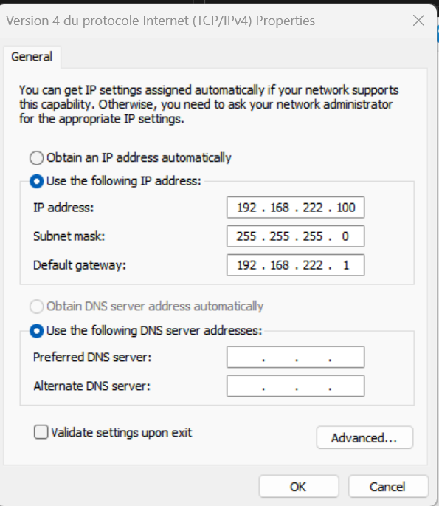
Activity: Sharing file between VM and Host PC
Step 2: Right-click vEthernet (name of switch) -> Properties (raise your hand to get help with Admin permissions)
Step 3: find and click on Internet Protocol Version 4 (TCP/IPv4) -> click Properties
Step 4: Select “Use the following IP address” and enter ➔

Slide 45
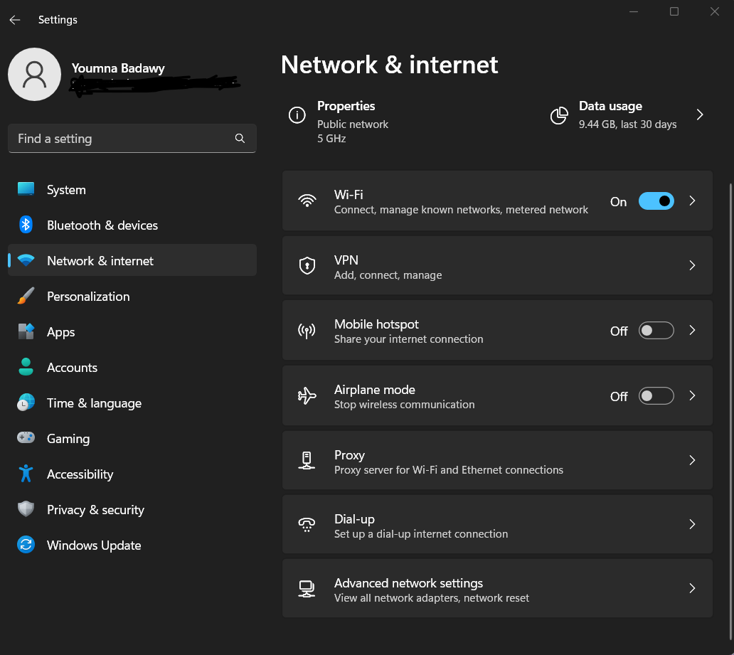
Activity: Sharing file between VM and Host PC
Step 5: on Guest Machine
Open Settings> Network & Internet > Advanced network settings > Advanced sharing settings > Private Networks -> enable all -> Press okay and close window

Slide 46
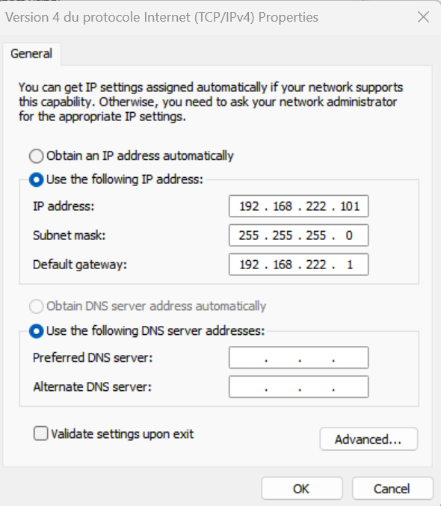
Activity: Sharing file between VM and Host PC
Step 6: on Guest Machine
Change the Adapter Options of the Ethernet switch:

Slide 47
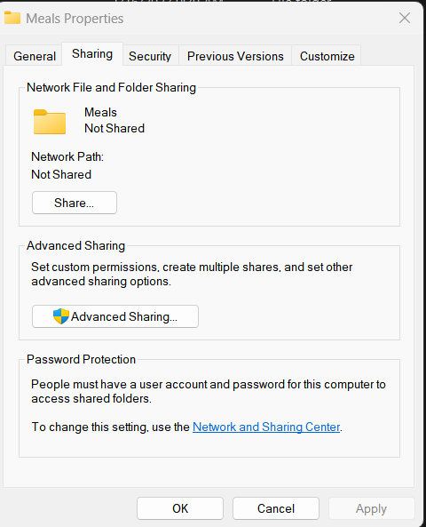
Activity: Sharing file between VM and Host PC
Step 7: Let’s now create a folder C:\Users\<yourID>\Meals on the Host and share it with the Guest PC.
Step 8: Add a fille inside the folder breakfast.txt
Step 9: Right click the folder and click on Properties

Slide 48
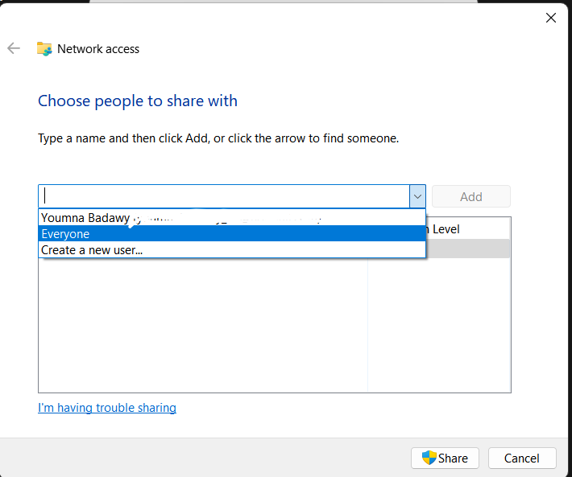
Activity: Sharing file between VM and Host PC
Step 10: Select Everyone
This means anyone on the same network will be able to see this folder.
Note: You could also add other users of this machine.

Slide 49
Resources
https://docs.microsoft.com/en-us/virtualization/hyper-v-on-windows/
https://docs.microsoft.com/en-us/windows-server/administration/performance-tuning/role/hyper-v-server/storage-io-performance
https://docs.microsoft.com/en-us/windows-server/storage/disk-management/manage-virtual-hard-disks
https://docs.microsoft.com/en-us/virtualization/hyper-v-on-windows/quick-start/connect-to-network
https://docs.microsoft.com/en-us/windows-server/virtualization/hyper-v/get-started/create-a-virtual-switch-for-hyper-v-virtual-machines
https://www.veeam.com/blog/hyper-v-dynamic-memory-managing-vm-ram.html
https://www.nakivo.com/blog/hyper-v-generation-1-vs-2/
https://docs.microsoft.com/en-ca/sysinternals/downloads/process-explorer
https://superuser.com/a/1301826

Slide 50
Additional Challenge
Create a Linux Virtual Machine
Check which version of Linux is compatible with Hyper-V here: https://learn.microsoft.com/en-us/windows-server/virtualization/hyper-v/supported-ubuntu-virtual-machines-on-hyper-v
Usually, LTS versions are supported.
Download the .iso file from here: https://ubuntu.com/download/desktop
Make sure to select the minimum system requirements
Follow the installation steps:
https://wiki.ubuntu.com/Hyper-V

Slide 51
Q & A
Notes:
In Slide Show mode, click the arrow to enter the PowerPoint Getting Started Center.

